Slide 1

Dashboard Confessional: Revealing the Secrets of Data Visualization
Jeremy Goldstein
Minuteman Library Network
jgoldstein@minlib.net

Slide 2
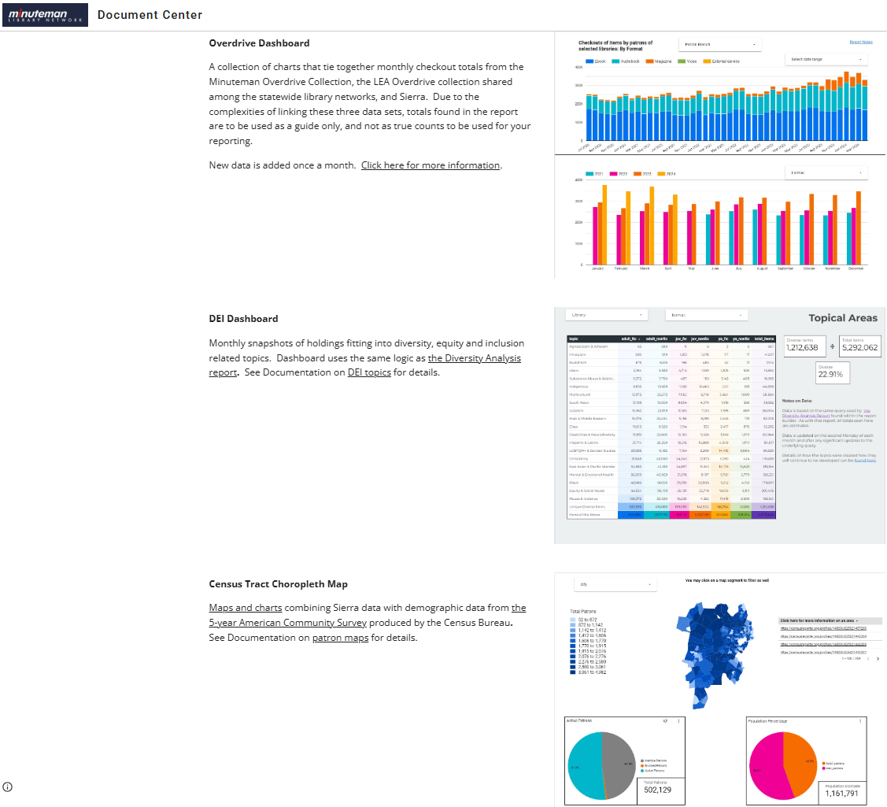

Notes:
We primarily build our dashboards within Minuteman using Google’s Looker Studio as we’re largely a Google shop already, it plays nicely with other Google tools, the sharing options work perfectly for our needs, and it’s FREE! And we do a lot with them. For just a few of the more interesting example we have out Overdrive dashboard tying together our Consortia, advantage and state-wide collections with some Sierra data. We have an attempt at a DEI collection development dashboard based around LC subjects and a whole lot of truly terrible regular expressions. And we have our Census dashboard linking patron addresses to census demographics.

Slide 3
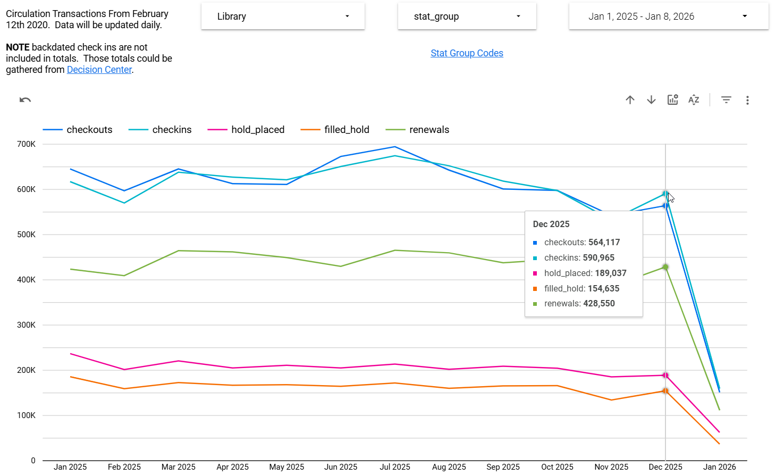
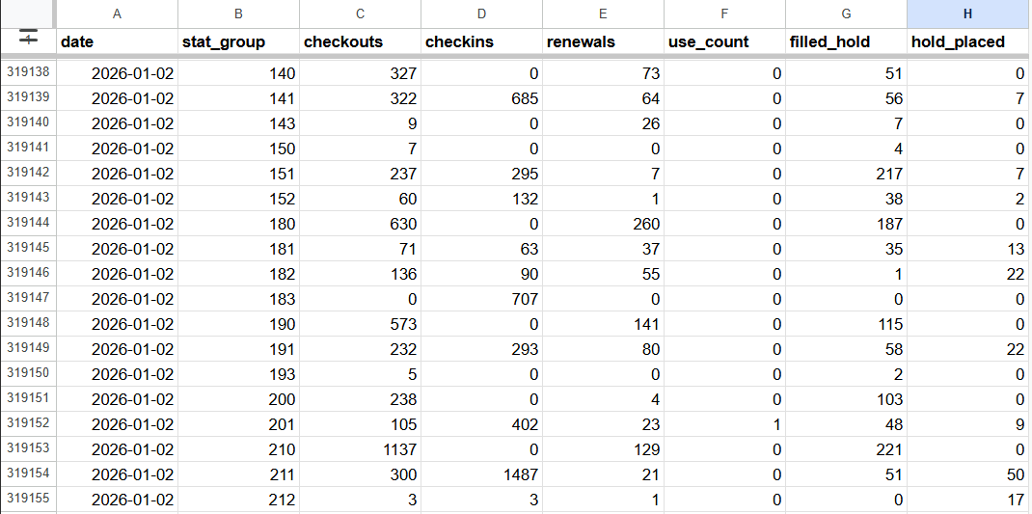
Notes:
Behind every visualization is a table, sometimes a few and the data structure of that table informs what you can and can’t do. For us most of these are simply Google private Google docs that work as data sources, though we’ve also taken to storing data in a bigquery database for a few projects.

Slide 4
Tables
Data is organized into rows and columns
Columns = Data Fields, content shares a data type
Rows = Individual instances of those fields
Notes:
If you’re here you know what a table is, but the structure of the table you’re working with can be critical to what you may wish to accomplish with it. As a table each column is narrowly defined to contain data of a particular data type: text, integers, timestamps, Boolean values, each of which may be controlled in other ways as well such as whether or not null values are allowed. Rows are then individual instances within the table representing a record, a transaction, an object representing something that can be represented by the combination of those particular fields.

Slide 5
Metrics and Dimensions
Dimensions: Attributes of your data
Non-Numeric values and dates
Use for Axes
& filters
Required
Metrics:
Quantitative data
Use for plotting points within charts
Optional
Notes:
Taking this table into the real of data visualization tools there’s an additional way we need to consider the table structure and that is which columns represent dimensions and which are metrics.
Dimensions are attributes of your data, generally text (potentially numbers being treated as text) or dates. These are the elements that populate the axes of charts or that may provide filtering options. Metrics are quantitative data, the information that you wish to use a chart to actually measure.
You will almost always have metrics, but they are technically optional as there are visualizations that do not require them or that can work by simply providing counts of the dimensions themselves
In this example the dimensions are the transaction dates and the stat group column representing the terminal where each transaction occurred.

Slide 6
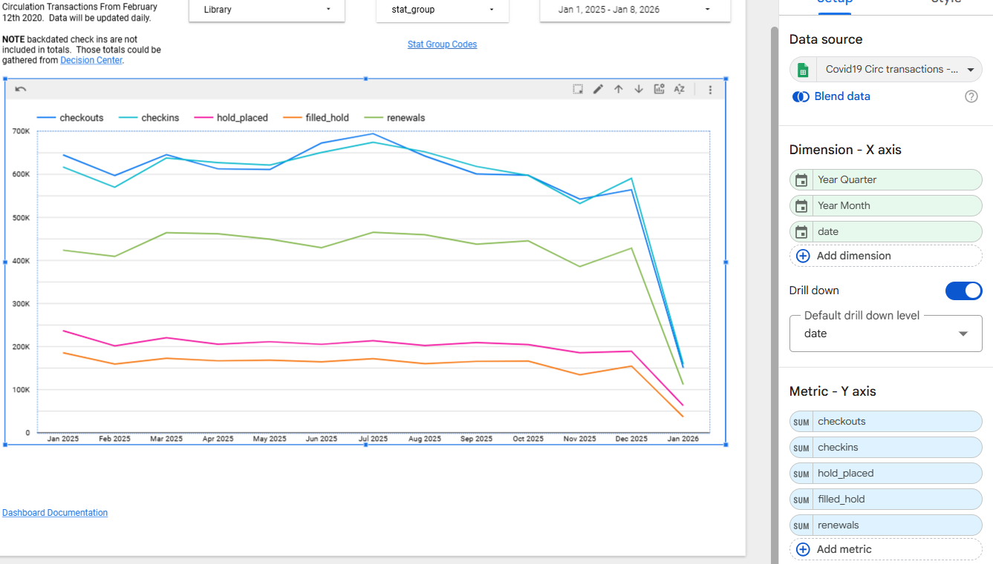
Metrics and Dimensions
Notes:
Here’s the edit mode in looker studio. For a line graph of this sort it requires a dimension field (date…which can be aggregated if we wish into different timespans) for the x axis and at least one metric field (various transaction types) as the y axis. Then the y dimension is just calculated from the sum of that metric, in this case, given the nature of our data we can include separate metrics for each of our transaction types, all mapped to the y axis.

Slide 7
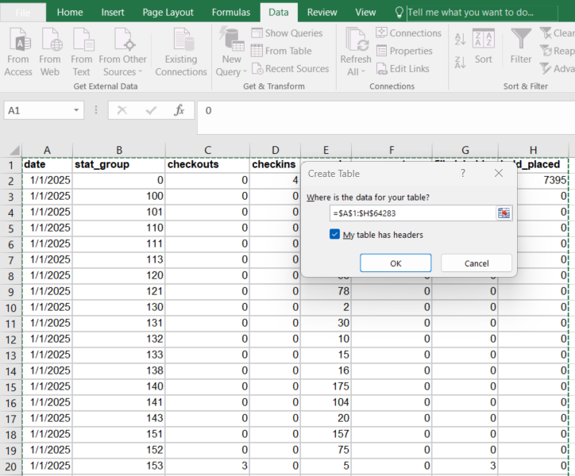
My Favorite Excel Trick
Notes:
Now for my favorite thing to do in excel. Here’s the raw form of the chart we were just looking at, and we’re going to just Excel’s Get and Transform / Power Query to change the shape of the data and unlock different ways to use the data. This is using Excel 2016 which I will cling to for as long as I possibly can as the get and transform features in office 365 are more restrictive from what I’ve seen, at least in the cheaper versions.

Slide 8
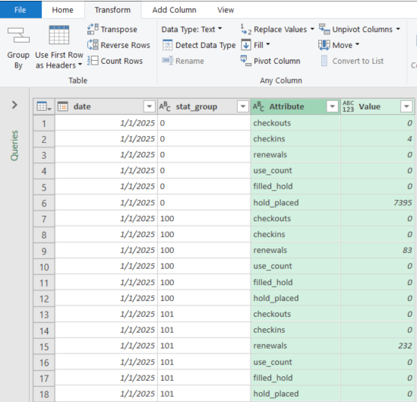
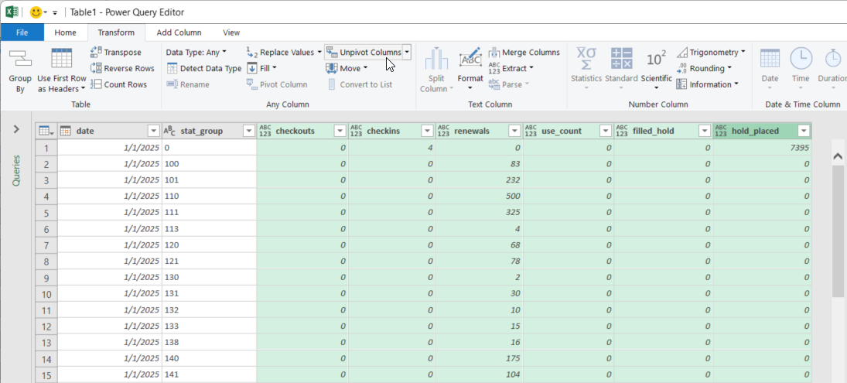
Unpivot
Notes:
Unpivot is found under the transform tab. Here you can select all the columns representing different transaction types, click on unpivot, and suddenly we have reduced our table to four columns in such a way that transaction type can be treated as a dimension.

Slide 9
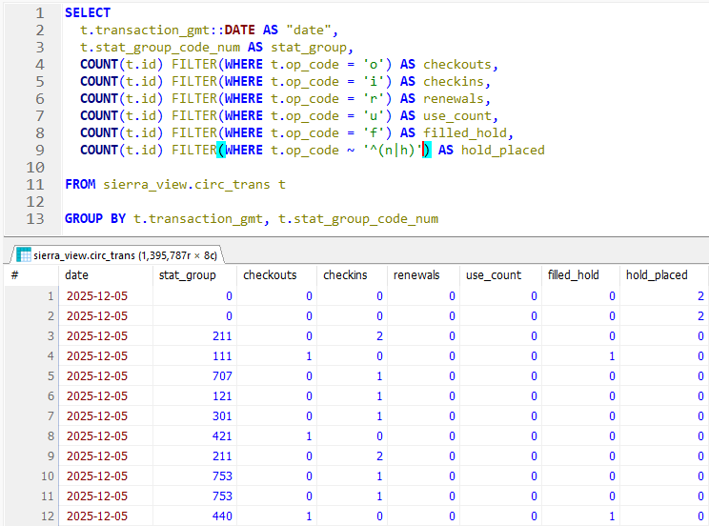
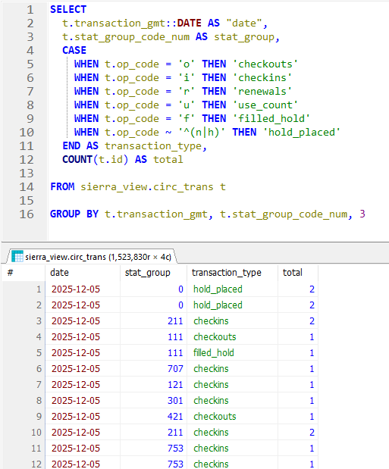
Unpivoting with SQL
Notes:
Now the unpivoted is essentially the more natural way for the data to exist in SQL already, but this is one example showing that by considering the query you write you can reshape your data to fit your exact needs. On the left we have a query output matching our original table, using a bunch of filter() functions to provide different subsets of the total transaction count. On the right we have a form matching our unpivoted table, here using a case state to break out the transaction types that we care to group our totals on.

Slide 10
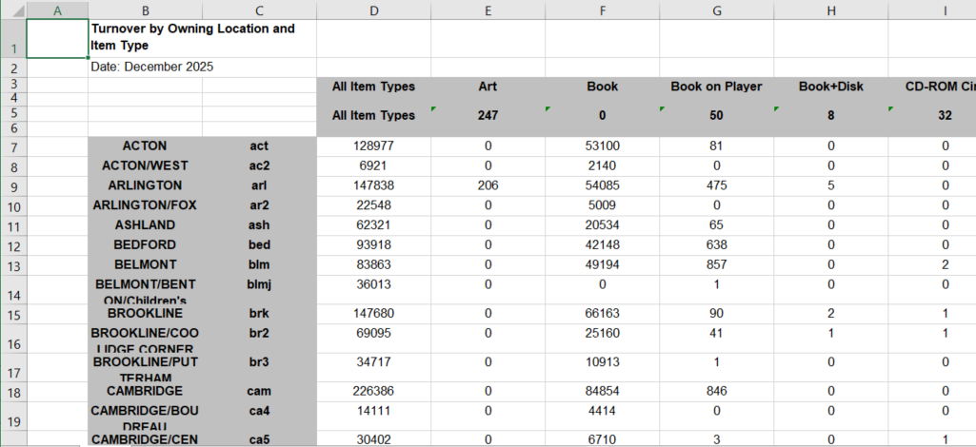
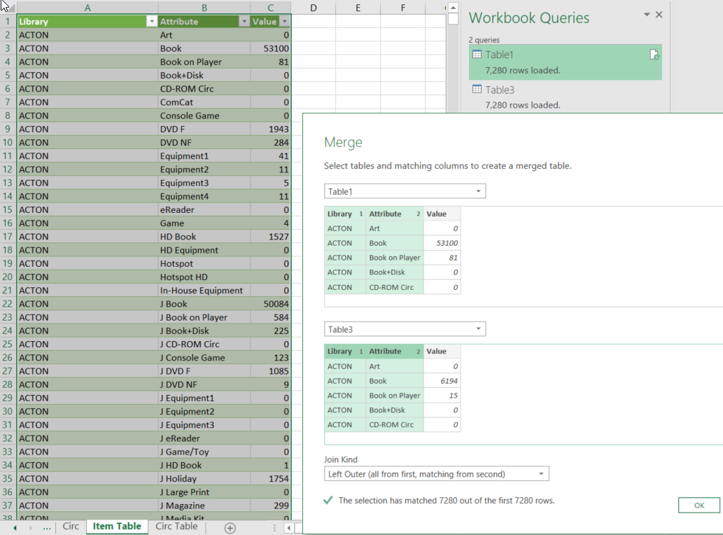
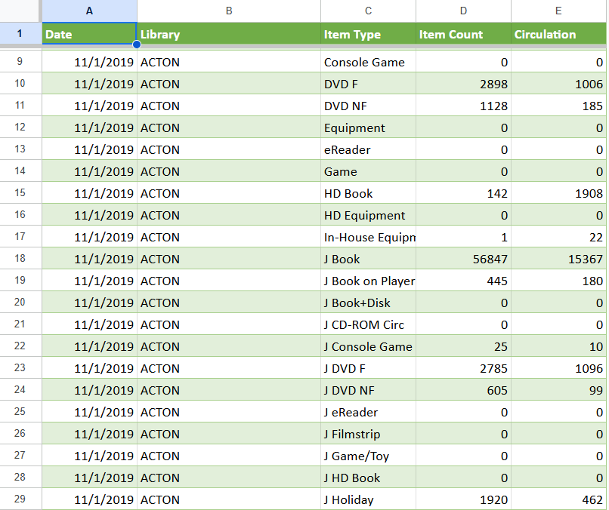
Notes:
For a practical example of this in action, our holdings dashboard takes the turnover by owning location and item type report from Decision Center, which produces separate spreadsheets for item counts and circ counts. These can be exported in the format you see at the top. So you do have to edit that a bit before doing anything else to eliminate the excess spacing and get rid of the All item types column that we don’t actually need as our visualization tool will handle totaling. With that formatted to our needs we can unpivot the data as we just saw producing a pair of tables similar to what you see in the left with 3 columns, library, item type and a total. Once we have those two tables we can use the merge function to join them together on library and itype to get our final table. The date column I just add in manually since it’s a single value representing the month for all rows, which only matters when we’re tracking this information over time.

Slide 11
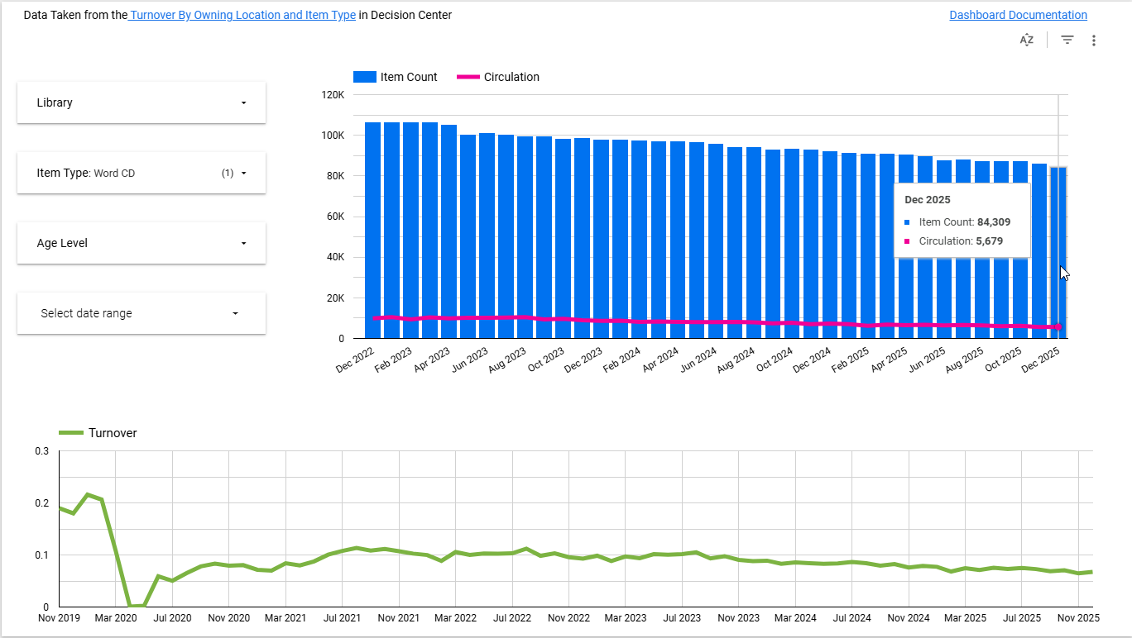
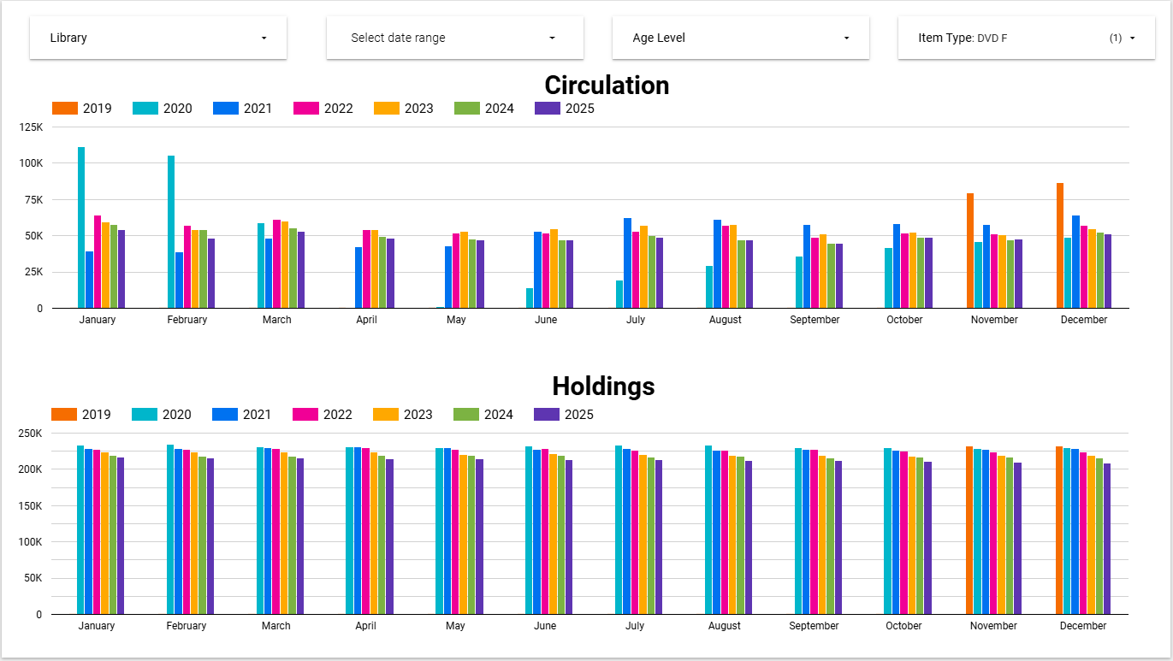
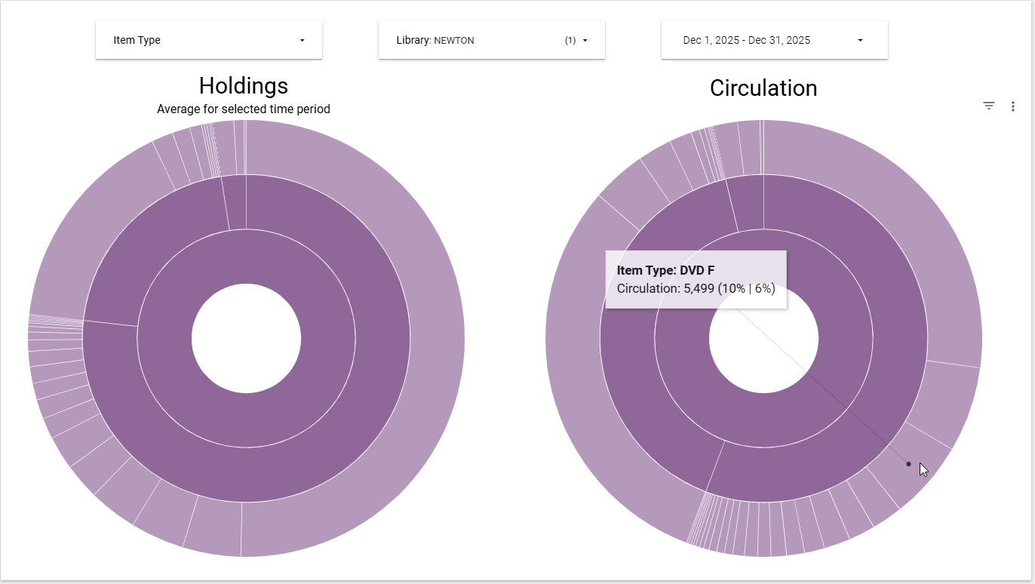
Notes:
As in our dashboard which features a whole bunch of charts, all using this single considered table taken from unpivoting a report produced in Decision Center on a monthly basis
For the sunburst chart example the two percentages are showing that the dvd f itype represents 10% of the checkouts among items in the adult segment of that chart (the middle ring) and 6% overall. Compare to 6% and 4% of holdings (2nd largest segment) in the chart to the left. And yeah you can very clearly see the drop off in the use of books on cd’s since lockdown.

Slide 12
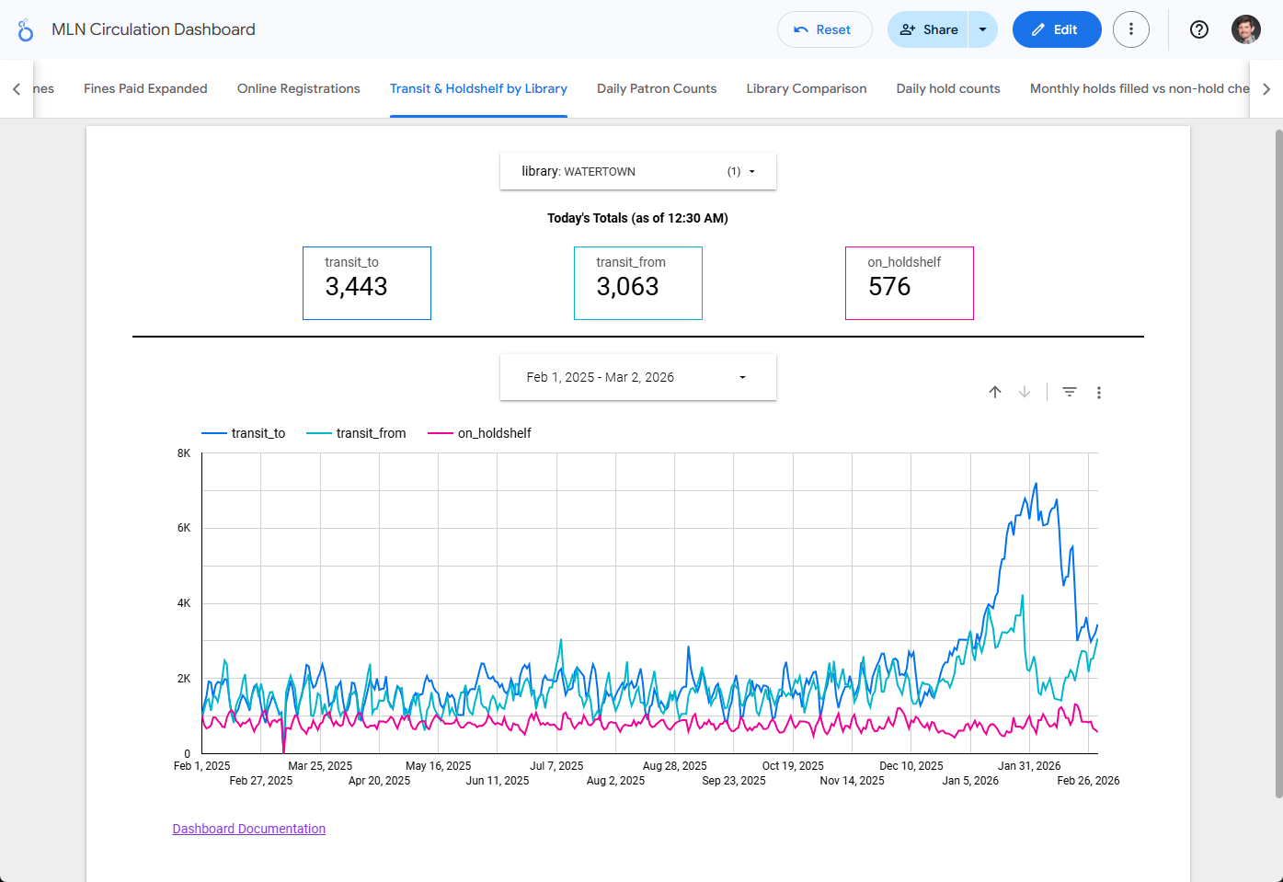
Notes:
That dashboard is updated manually each month, but many of ours such as this piece of our circ dashboard are purely automated. This dashboard currently has 13 pages of charts in total, providing DAILY counts of transactions, records of fines, online registrations, unique user counts and as seen here that state of items moving through between libraries in the network, generally tracing back to 2020. All of this is way too much to handle manually on a daily basis but automating it has made these charts into something I can set and forget. Incidentally the weird spike seen here in the transit counts is because the state’s delivery service had their two largest trucks out of commission for a bit on this library’s route and it was painful.

Slide 13
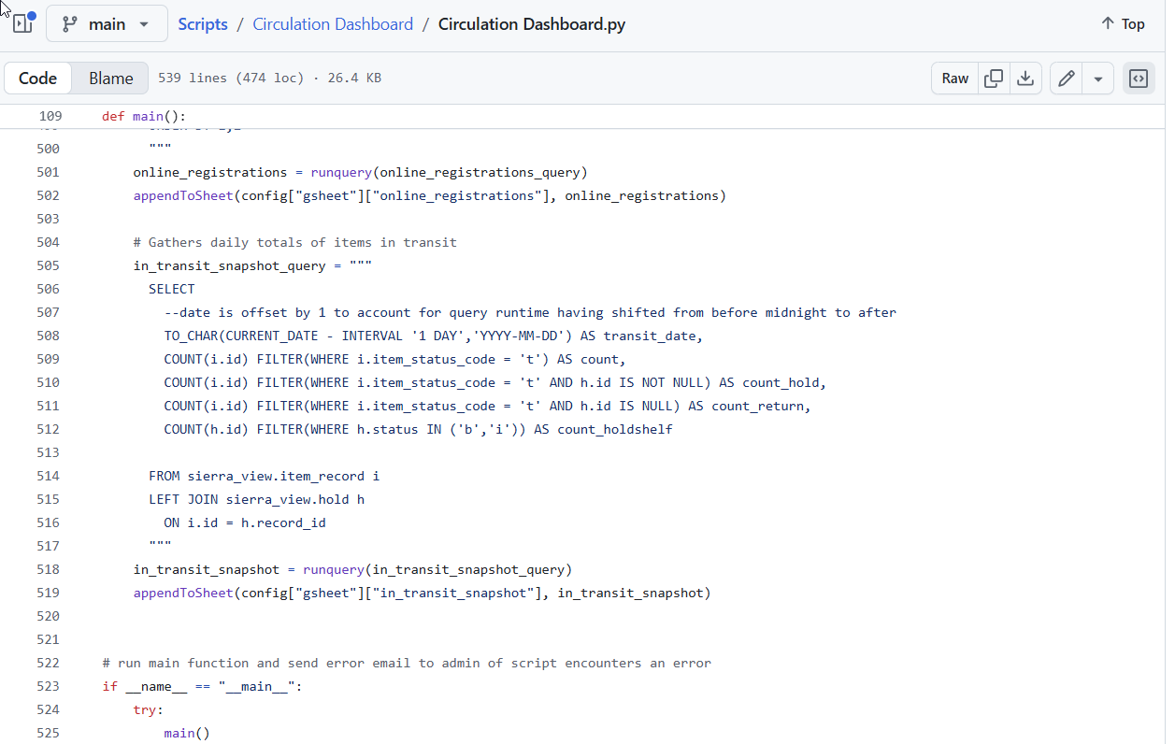

For more come to Automating Reports with Python 2: Getting Modular
Tuesday April 14 10:30 am Kansas City
Notes:
The script used to run all these searches each day and update a set of Google sheets serving as our data sources is available here. And if you are interested in learning more about how to develop scripts like that please come to my session on Tuesday.

Slide 14
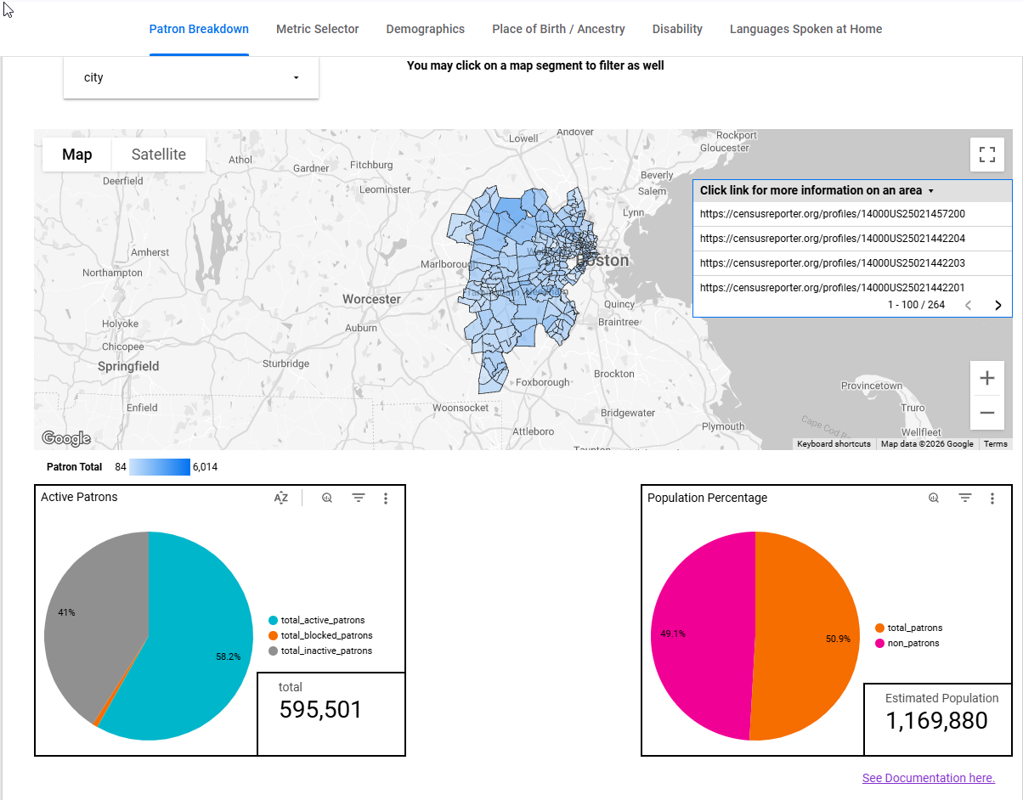
Notes:
Going to something a bit more ambitious, our most popular dashboard is our collection of census maps that combine anonymized patron data from Sierra (aggregated on census tract id stored in a varfield) with census bureau demographics. Using these our libraries can quickly pinpoint neighborhoods within their communities that they are serving well or possibly underserving and get a sense of the demographic make up of those areas.

Slide 15
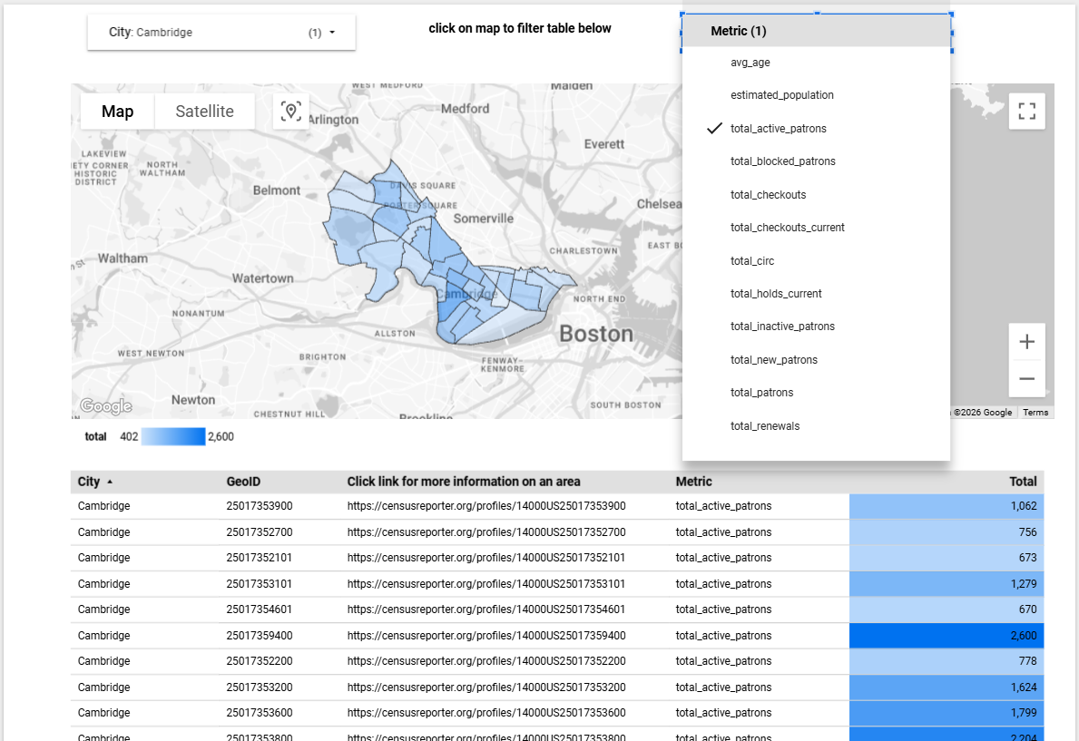
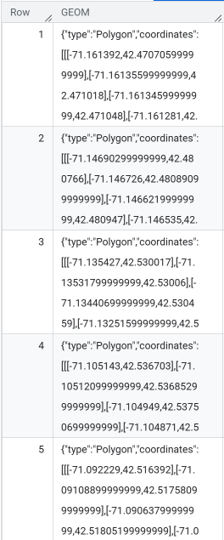
Notes:
Most of the underlying table here is actually pretty straightforward, and exposed right in the dashboard. The exception being the GIS data needed for the map, which we’re getting right from the census bureau…along with the estimated_population stat. The one key bit that isn’t visible (because it’s not really intended to be human readable) is the geometry field that provides the coordinates necessary to describe each region of the map…again data that’s available via the census bureau. Then we simply merge our data with theirs on a point in common, in this case the geoid value that we happen to plug into our patron records. Now I said simple, but the obnoxious bit with Looker Studio at the moment is that the current limitation on using custom geographic areas with a map is that the data needs to be stored in a geojson format (which is not what the census bureau provides, though it can be converted without too much trouble) in Google’s big query service. So this one is a bit more difficult to manage than our other automated dashboards and can actually accumulate some costs. Our bigquery usage comes out to something like 20 cents a month between this and the database we’re storing our overdrive data extracts in.

Slide 16
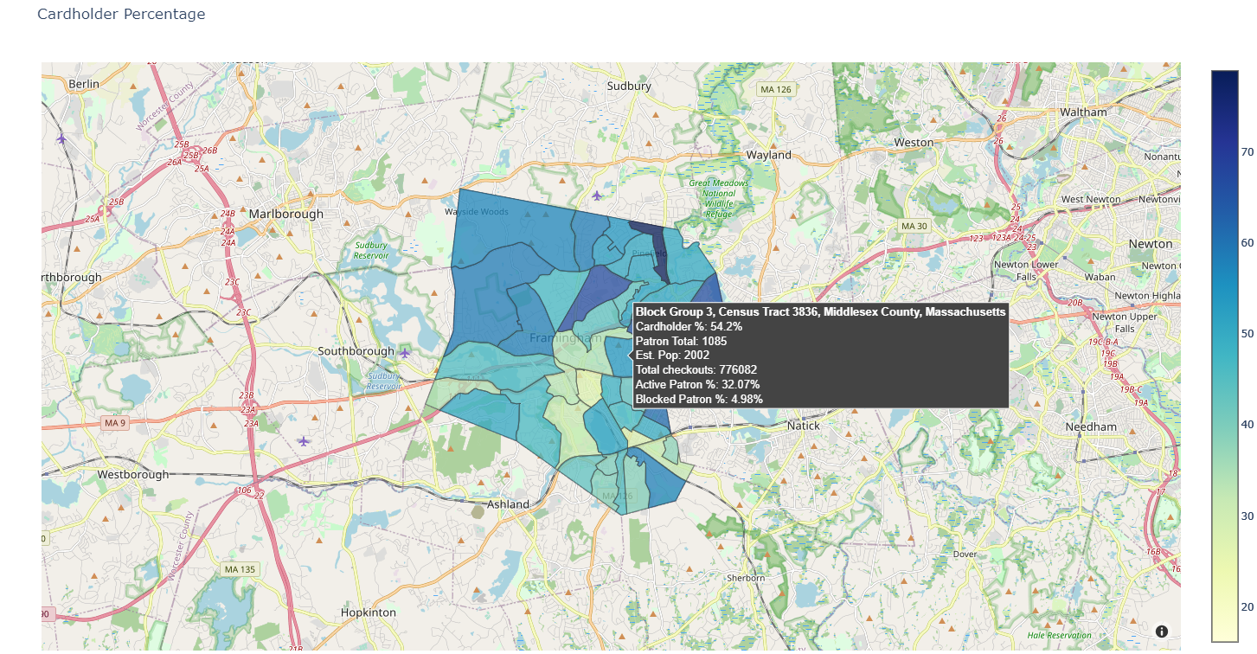

https://github.com/Minuteman-Library-Network/Scripts/tree/main/Patron%20Maps
Notes:
If that’s too complicated we also produce html versions of some of these sorts of charts using the more granular (but less accurate) census block group geography. These are automatically created using Python scripts to produce .html files. You are welcome to copy our script here (for tips on running reports like this, come to my main conference presentation). As mentioned with the prior slide, all this information is dependent on having census geoids in our patron records which we also have a script to accomplish that can be accessed from the readme at that link.

Slide 17
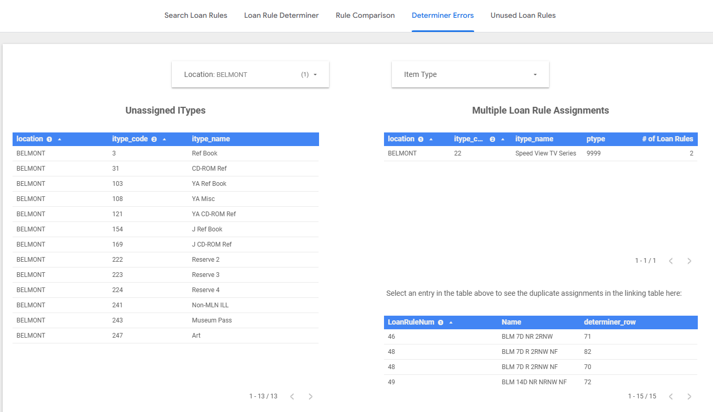
Notes:
Finally just for some inspiration on a different sort of dashboard. We have one that purely exists to make it easier to review the loan rule and loan rule determiner tables. This one does take some manual work to maintain as we have to export the tables directly from the Sierra client on a regular basis, run them through a script that splits apart ranges of itype and ptype values and then overwrite tables in the database this is reading from…which we do about every 6 weeks with the occasional bonus if working through a project involving a large number of updates. But that’s worth it for the ability to freely explore our 700+ rule table. We can do things like you see here to identify itypes that have been assigned to multiple lines by mistake, or haven’t been assigned at all by one of our libraries. Beyond that staff can model which rule a given combination of itype/ptype/checkout location will resolve to and see at a glance what loan policies other libraries in the network have opted to use to help inform their own decision making.

Slide 18
Thank You!
Jeremy Goldstein
Minuteman Library Network
jgoldstein@minlib.net

